Slide 1
Typescript design patterns applied to React/SPFx
Luis Valencia
Notes:
This slide is mandatory. Please do not remove.

Slide 2

Luis Valencia
Senior Solutions Architect
PwC Belgium
luisevalencia.com
@levalencia
17 years of experience, 10 in Sharepoint, 2 times MVP

Slide 4
Notes:
This slide is mandatory. Please do not remove and try to use it during Q&A at the end of your session. Thank you!

Slide 5
WiFi Keys for Attendees
Connect to the wireless network MSFT_GUEST
Login details for the wireless network:
Guest Username O365Sat@outlook.com
Guest Password: 0195

Slide 6
What is this session about?
This session is about showing clean code, code that is clean and that solves common problems in a way that anyone can maintain later.
This session is not about cool web parts showing cool graphical user interface , this session is aimed to the developer who wants to learn something about how to write clean and maintainable code.

Slide 7
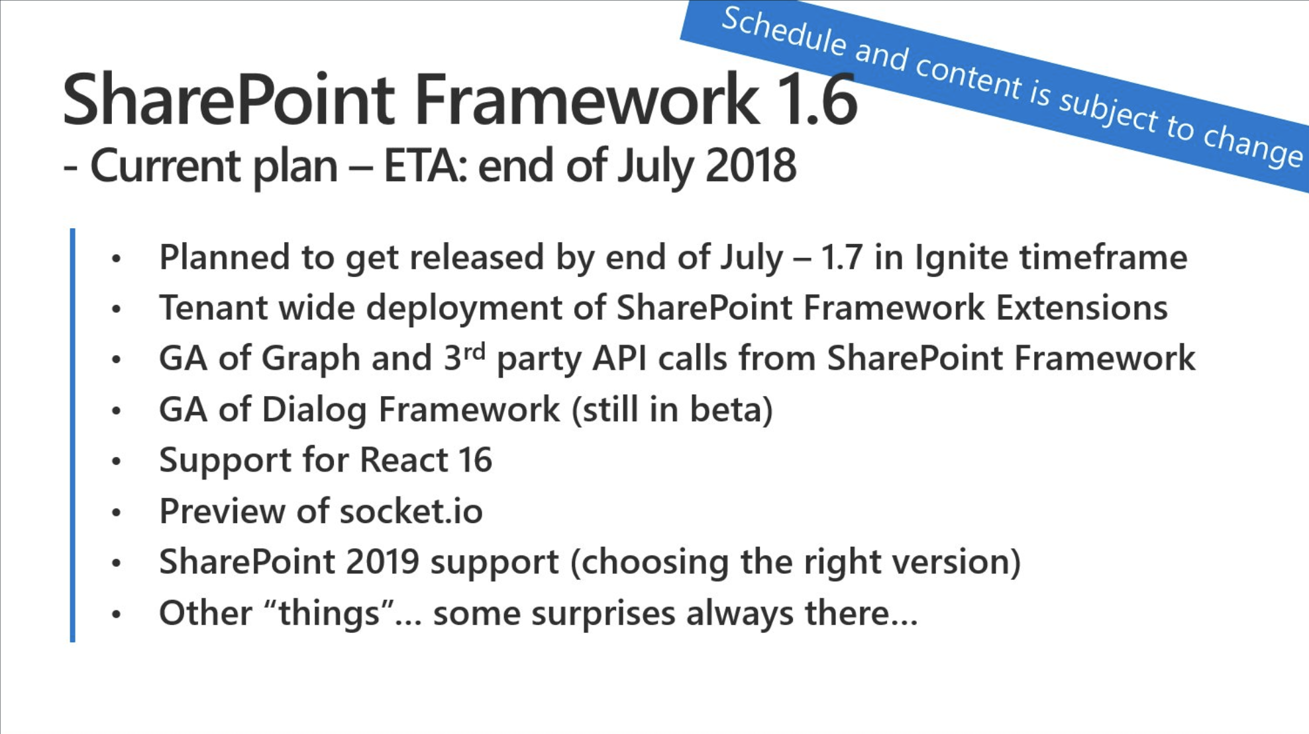

Slide 8
Cool SPFx Bloggers
https://blog.mastykarz.nl/
Building dll-code in SharePoint Framework
Building shared code in SharePoint Framework – revisited
https://www.eliostruyf.com/
http://www.sharepointnutsandbolts.com/ (Chris O’Brien)
https://medium.com/inherits-cloud (Luis Mañez)
https://delucagiuliano.com/ (Giuliano de Luca)
http://blogs.encamina.com/desarrollandosobresharepoint/ (Adrian Diaz)

Slide 9
User voice
Add support for library packages in the SharePoint Framework
https://bit.ly/2rVBZOv

Slide 10
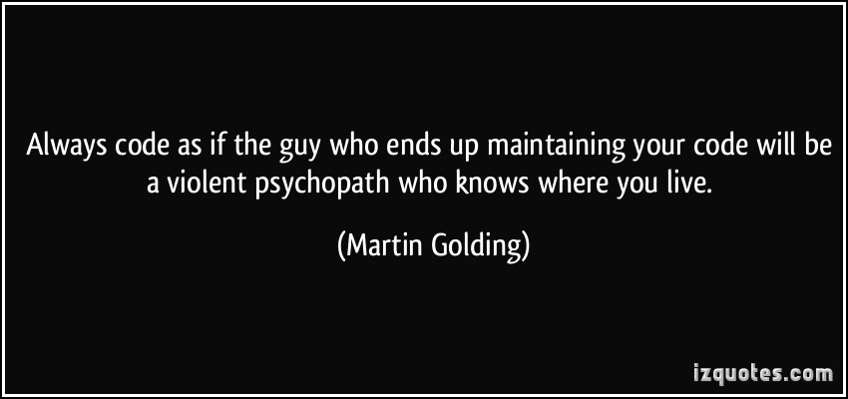

Slide 11
Gang of Four
Design Patterns: Elements of Reusable Object-Oriented Software is a software engineering book describing software design patterns. The book's authors are Erich Gamma, Richard Helm, Ralph Johnson and John Vlissides with a foreword by Grady Booch. (1994)
It has been influential to the field of software engineering and is regarded as an important source for object-oriented design theory and practice. More than 500,000 copies have been sold in English and in 13 other languages. The authors are often referred to as the Gang of Four (GoF).

Slide 12
Design Patterns
In software engineering, a design pattern is a general repeatable solution to a commonly occurring problem in software design. A design pattern isn't a finished design that can be transformed directly into code. It is a description or template for how to solve a problem that can be used in many different situations.
The 23 Gang of Four (GoF) patterns are generally considered the foundation for all other patterns. They are categorized in three groups: Creational, Structural, and Behavioral.

Slide 13
Benefits of design patterns
Design patterns have two major benefits:
First, they provide you with a way to solve issues related to software development using a proven solution making the overall system easier to understand and maintain.
Second, design patterns make communication between designers more efficient. Software professionals can immediately picture the high-level design in their heads when they refer the name of the pattern used to solve a particular issue when discussing system design.

Slide 14
Creational Design Patterns
These design patterns are all about class instantiation. This pattern can be further divided into class-creation patterns and object-creational patterns. While class-creation patterns use inheritance effectively in the instantiation process, object-creation patterns use delegation effectively to get the job done.
Singleton A class of which only a single instance can exist
Abstract Factory Creates an instance of several families of classes
Builder Separates object construction from its representation
Factory Method Creates an instance of several derived classes
Object Pool Avoid expensive acquisition and release of resources by recycling objects that are no longer in use
Prototype A fully initialized instance to be copied or cloned

Slide 15
Singleton
A singleton is a pattern that guarantees there is a single instance of an object in the system. A singleton can maintain a state which is shared across the entire system. Singletons abstract their internal workings from the rest of the system.
Scenario:
Any application at some point will need to read configuration variables from somewhere, imagine a SPFx webpart which is a complex SPA with many screens and forms where you need to rely on a configuration Sharepoint List, where you store information like: Number of Items per page, Max Number of Connections, Timeouts, Max Number of devices allowed, and things like that.
In this scenario it makes sense to build a class that will allow you easy retrieval of those values without you having to write code to retrieve the values in all screens or forms on the SPA.
It is a poor practice to repeat configuration access code everywhere in the system. If the physical location of configuration ever changes one would have to update many different files and lines of code. To solve this, developers implement a singleton for managing configuration.
For this sample only one file need to be added and the .tsx file modified to use the Singleton Pattern.

Slide 16

SHOW ME THE CODE
Singleton

Slide 17
Abstract Factory
The Abstract Factory Pattern usually defines the interfaces of a collection of factory methods, without specifying concrete products. This allows an entire factory to be replaceable.
For the sake of simplicity lets suppose you work at Company A, and company A acquired company B, at company A you have a webpart developed that brings Customer Information from Sharepoint List, but at Company B which was acquired and in the process of merging, they have Customer Information in their own CRM which exposes data via REST APIs or just a JSON file.
The users wants to see their Customers in the same Sharepoint page using the same webpart, meaning that the webpart needs to be added twice with different parameters to the same page and users can search for customers information on both data sources, with the same source code.

Slide 18

SHOW ME THE CODE
Abstract Factory

Slide 19
Builder
Builder pattern builds a complex object using simple objects and using a step by step approach. This type of design pattern comes under creational pattern as this pattern provides one of the best ways to create an object.
A Builder class builds the final object step by step. This builder is independent of other objects.
The idea on this example is to show how you can build a Complex object from single objects, a Meal from (burger, fries, soda). Suppose you have a Sharepoint List for Burgers, another list for Sodas, another one for desserts, and you want to build different Meals (Menus), so this would be a perfect sample.

Slide 20

SHOW ME THE CODE
Builder

Slide 21
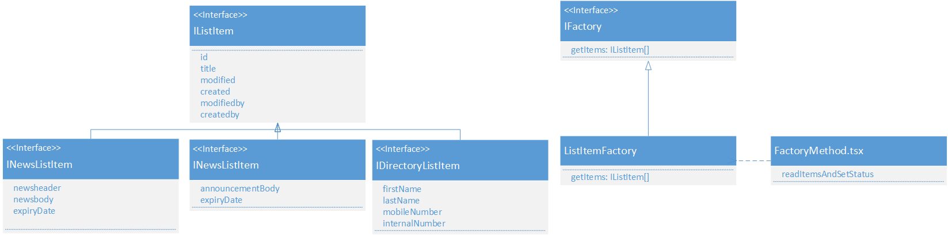
Factory method
Under some scenarios, a class cannot predict exactly what objects it will create, or its subclasses may want to create more specified versions of these objects. Then, the Factory Method Pattern can be applied.
Advantage of Factory Design Pattern
Factory Method Pattern allows the sub-classes to choose the type of objects to create. It promotes the loose-coupling by eliminating the need to bind application-specific classes into the code. That means the code interacts solely with the resultant interface or abstract class, so that it will work with any classes that implement that interface or that extends that abstract class.
A factory method is a method of a factory that builds objects
From Book: Typescript Design Patterns

Slide 22

SHOW ME THE CODE
Factory method

Slide 23
Structural design patterns
These design patterns are all about Class and Object composition. Structural class-creation patterns use inheritance to compose interfaces. Structural object-patterns define ways to compose objects to obtain new functionality
Adapter Match interfaces of different classes
Bridge Separates an object’s interface from its implementation
Composite A tree structure of simple and composite objects
Decorator Add responsibilities to objects dynamically
Facade A single class that represents an entire subsystem
Flyweight A fine-grained instance used for efficient sharing
Private Class Data Restricts accessor/mutator access
Proxy An object representing another object
https://sourcemaking.com/design_patterns

Slide 24
Behavior design patterns
These design patterns are all about Class's objects communication. Behavioral patterns are those patterns that are most specifically concerned with communication between objects.
Chain of responsibility A way of passing a request between a chain of objects
Command Encapsulate a command request as an object
Interpreter A way to include language elements in a program
Iterator Sequentially access the elements of a collection
Mediator Defines simplified communication between classes
Memento Capture and restore an object's internal state
Null Object Designed to act as a default value of an object
Observer A way of notifying change to a number of classes
State Alter an object's behavior when its state changes
Strategy Encapsulates an algorithm inside a class
Template method Defer the exact steps of an algorithm to a subclass
Visitor Defines a new operation to a class without change
https://sourcemaking.com/design_patterns

Slide 25
Git hub Repo
https://github.com/levalencia/sp-dev-fx-webparts/

Slide 26
What’s next? SOLID Principles
SOLID Principles are well-known Object-Oriented Design (OOD)principles summarized by Uncle Bob (Robert C. Martin). The word SOLID comes from the initials of the five principles it refers to, including Single responsibility principle, Open-closed principle, Liskov substitution principle, Interface segregation principle and Dependency inversion principle. Those principles are closely related to each other, and can be a great guidance in practice.
Here is a widely used summary of SOLID principles from Uncle Bob:
Single responsibility principle: A class should have one, and only one, reason to change.
Open-closed principle: You should be able to extend a classes behaviour, without modifying it.
Liskov substitution principle: Derived classes must be substitutable for their base classes.
Interface segregation principle: Make fine-grained interfaces that are client specific.
Dependency inversion principle: Depend on abstractions, not on concretions.

Slide 27
Single Responsibility Principle
What does it mean?
A class should only have a single responsibility.
How does React adhere to it?
React applications consist of components, which are classes that inherit from the React.Component class. You can start building your application as a component and if it gets too complex, you can split this component up into multiple smaller components.
React doesn't force you to adhere to the principle, but you can split up your component classes into smaller components till you achieved single responsibility for all of your components.
For example, you could have a button component that just handles clicks and an input component that just handles user input. A level above you use a form component that uses multiple instances of the button and input component to get user credentials and above that a connection component that takes form data and sends it to a server.
From Book: Typescript Design Patterns

Slide 28
Open Close Principle
What does it mean?
Software entities should be open for extension, but closed for modification. Which means you can extends it without modifying its source code.
How does React adhere to it?
Reacts component model is build around aggregation instead of inheritance. So you only extend the base React.Component and not its children. This prevents you from overriding behavior of existing components directly. The only way is to wrap it with your own component.
You could for example wrap a Button with a RedButton that always applies specific styles to the basic Button, but the Button is closed for modification.
This is less flexible than inheritance, but it also simplifies the API. While you don't have direct access to the methods like in an extension, you only have to care about props in your aggregation.
From Book: Typescript Design Patterns

Slide 29
Interface Segregation Principle
What does it mean?
Many client-specific interfaces are better than one general-purpose interface.
How does React adhere to it?
Because React is written in JavaScript, it benefits from the dynamic nature of this language. There are no formal interfaces. If you don't use refs, which allow you to directly call class methods of a component, the only interaction between components is via props and nobody forces you to use props you don't need.
If you have a wrapper component that passes down an onClick handler that shows an alert with the wrapped components class name, you can use this wrapper to wrap all components that use this onClick prop and if they don't, the handler is just ignored.
My experience with this fact was that it simplified many things, you wouldn't get lost in defining many small interfaces beforehand. The drawback was that I often found me in situations where I passed down props the wrapped component did simply ignore silently. At least glamorous-native threw a few warnings when I tried to pass down unknown CSS attributes. For this it often helps to use PropTypes or something.
From Book: Typescript Design Patterns

Slide 30
Dependency Inversion Principle
What does it mean?
One should depend upon abstractions, not concretions.
How does React adhere to it?
In practice, this principle is often followed by removing class names from other classes. Like, you could have a List that has Items, so you could get the idea to create your Item objects inside the List class, now you have your List tightly coupled with your Item. Somewhere in your List class is a new Item(...) or Item.create(...) etc.
React doesn't strictly adhere to it, you can pass an array of string to your List component and create Item children from it no problem.
But you can also tell the List it should simply render out its childrenindependent of what they are, maybe add some keys to it or justify them etc.
Now you can create an array of Items, sprinkle it with some HighlightItems, both created from different string arrays and put them inside your List who won't be the wiser.
From Book: Typescript Design Patterns

Slide 31
Liskov Substitution Principle
What does it mean?
Objects in a program should be replaceable with instances of their subtypes without altering the correctness of that program.
How does React adhere to it?
Well, it doesn't use inheritance at all. Sure you extend React.Component, but this class is essentially treated as abstract in React applications, you never directly create an object from it, so you never have to replace it with a child-class later.
On the other hand, you find yourself writing aggregations that should act like their wrapped components rather often. Like the Button I mentioned before. You want that RedButton to be already styled, but you also want it to act like the Button, but since the API between components always is just props, it's often simple to add something while your wrappers props are passed down to the wrapped component. Because everything is dynamic, your wrapper doesn't even have to know everything about the data that would originally be passed down to the wrapped component, in the RedButton example it would just have to know about the style.
From Book: Typescript Design Patterns

Slide 32
User voice
Add support for library packages in the SharePoint Framework
https://bit.ly/2rVBZOv

Slide 33
Thank you
www.luisevalencia.com @levalencia
Luis Valencia
Notes:
This slide is mandatory. Please do not remove.

Slide 34
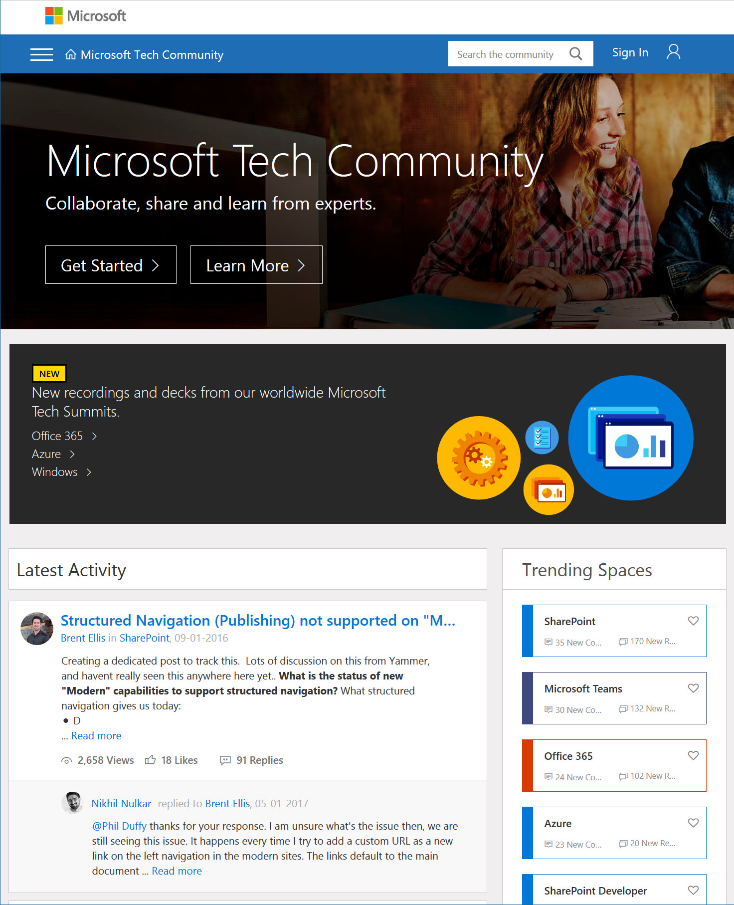
Microsoft Tech Community
techcommunity.microsoft.com
One Microsoft community for IT Pros and tech enthusiasts to learn from experts on Microsoft products
Trusted resource for news, best practices and answers from Microsoft product teams and MVPs
Join today! It’s free – sign in with your Microsoft Account.

Slide 35
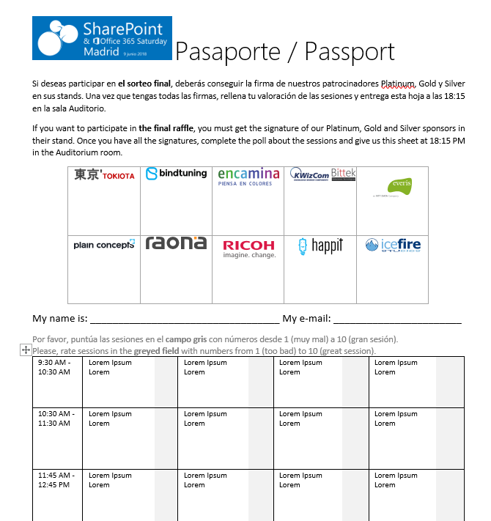

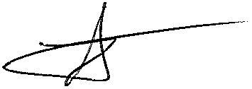


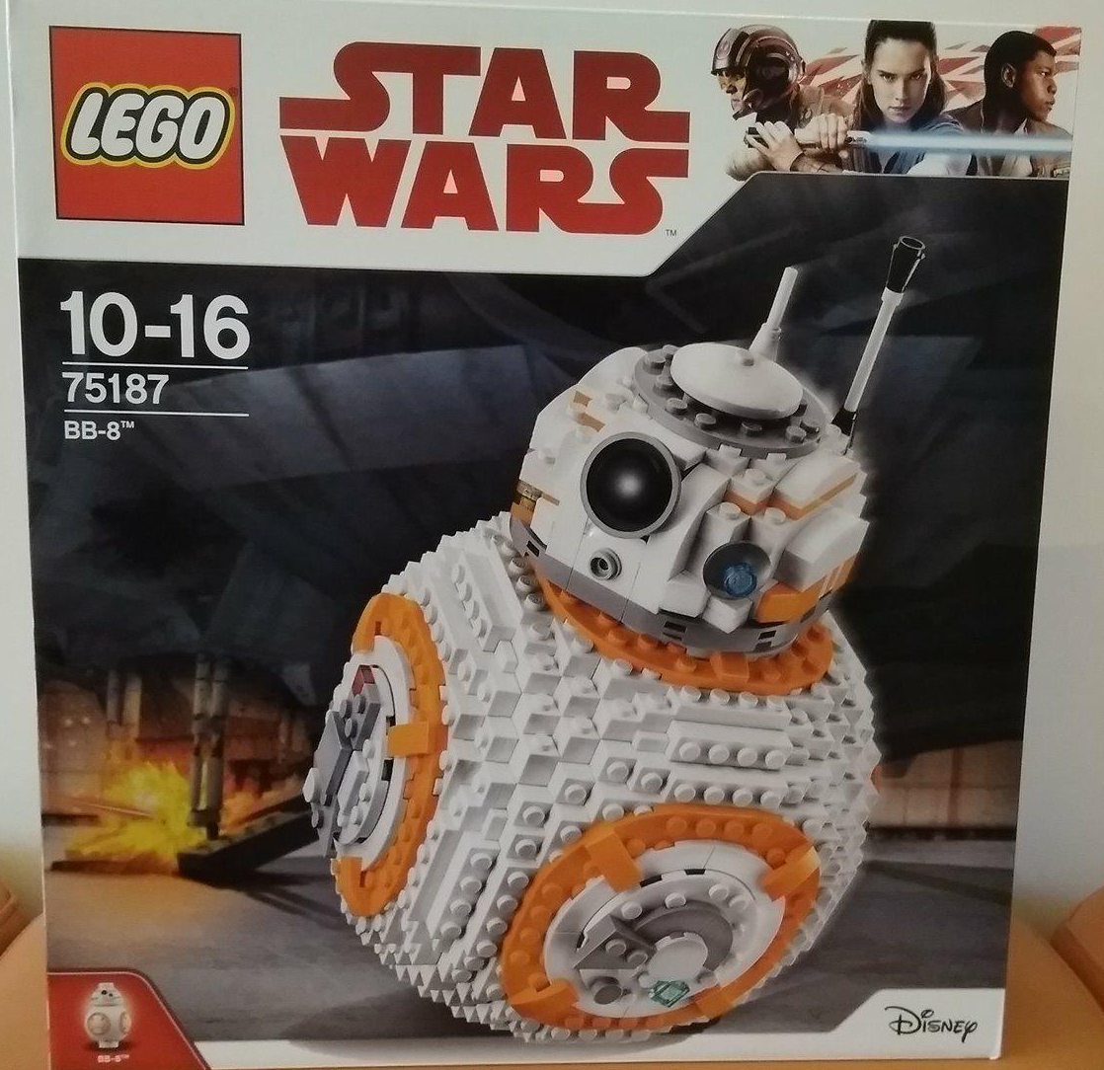






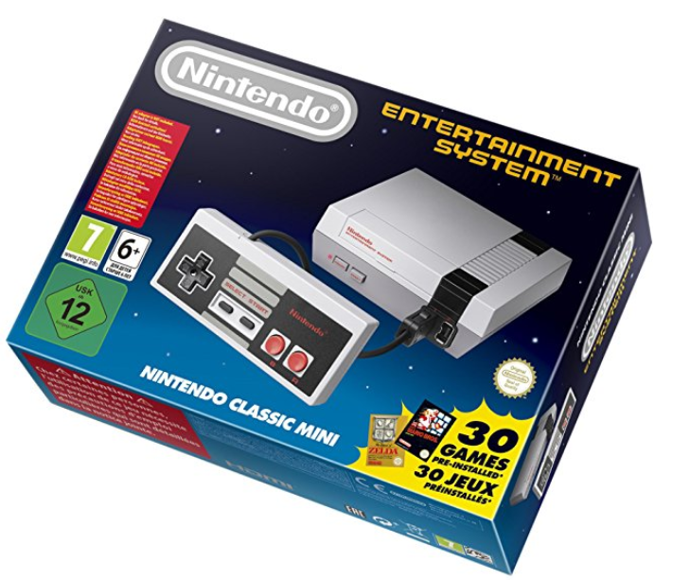
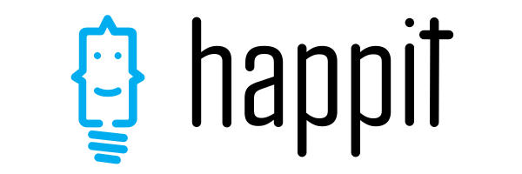



Raffle
Please, fill your SP & Office 365 Saturday Madrid passport if you want to participate.
You can win one of these gifts:
Please, fill your SP & Office 365 Saturday Madrid passport if you want to participate.
You can win one of these gifts:
Odor
Odor@winterfell.com
10
9
2x
2x
8

Slide 36

Office 365 for IT Pros
Get a discount of $10 buying the book here: https://gumroad.com/l/O365IT/spsspain

Slide 37
Notes:
This slide is mandatory. Please do not remove and try to use it during Q&A at the end of your session. Thank you!

Slide 38
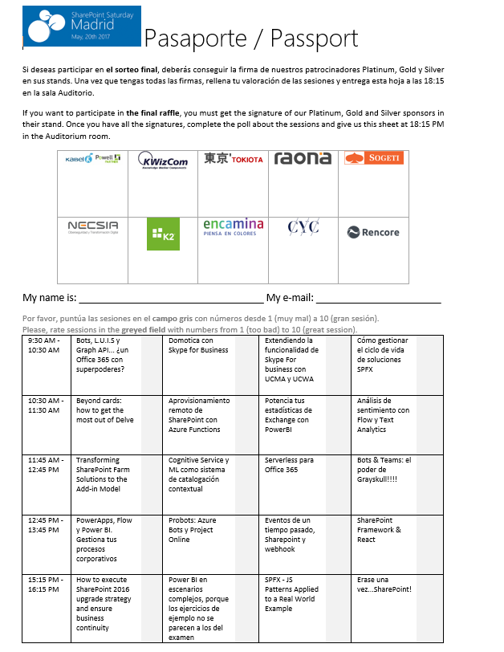
Raffle
Please, fill your SP & Office 365 Saturday Madrid passport if you want to participate.
You can win one of these gifts:
Odor
Odor@winterfell.com
10
9
8

